Slide 1

Lending Club – EDA Case Study Risk Analysis
Submitted By
Muniaraja Murugan
Group Facilitator
Email ID: muniarajam2011@gmail.com
Phone No: +1 2017230335
Vivek Trivedi
Team Member
Email ID:vivek3vedi@gmail.com
Phone no: +1 2484210721
3/8/2022

Slide 2
Contents
Case Study Objectives
Scope and Solution Approach
Introduction - Data Understanding
Data Cleaning & Manipulation
Data Preparation & Transformation
Descriptive Statistics → Finding Data Relationships & Correlation
Predictive Models → Univariate, Bivariate and Multivariate Analysis
Data Analysis
Recommendations
Prescriptive Models → Visual Aids(Data Visualizations & Inferences)
Conclusions

Slide 3




Scope, Objective & Solution
Scope
Objective
As a Data Scientist, help Lending Club(A marketplace for personal loans) to understand the driving factors behind loan defaulters and risky applications.
Lending Club can utilize this knowledge for its portfolio, risk assessment, acquire more customers and to maximize its revenue.
Leverage various Data Science techniques, models and algorithms of Exploratory Data Analysis(EDA) and discover patterns, spot anomalies, risky loan applications and derive inferences/ insights from the data shared
Translate the inferences into prescriptive recommendations that can be utilized by Lending Club to reduce the credit loss
Solution Approach
Data Manipulation
&
Transformation
Data Cleaning
Data Analysis
Recommendations
Null value verifications (Delete and Drop Columns)
Delete duplicate values
Perform type check
Data formatting and structuring to promote interoperability
Enable higher degree of data quality
Univariate Analysis
Continuous and Categorical
Bivariate/Multivariate Analysis
Correlation
Visualization & Reporting
Graphs and Insights
Prescriptive Decision Making

Slide 4
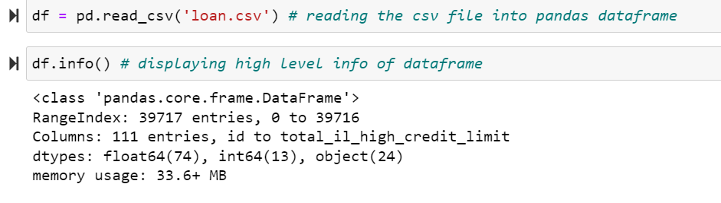
Cleaning of Lending Club Data
Why Data Cleaning required?
First step in Data Science
Identify and Solve Data Quality Problems
Makes Data Credible
How did we clean the Lending Club Data?
Snap Screen-Shot
Identify and Remove Missing Values and Duplicate rows in Loan Dataframe
Removing columns that are not useful for analysis
Formatting columns data, data correction into the right format
If the column has few null values, impute the missing values(Ex. In our data set, AMT_ANNUITY)
Findings from Data Cleaning
The raw data file had 111 columns and 39717 Rows
54 columns were having null values and deleted them
Deleted additional 15 columns which are not useful for analysis

Slide 5
Analysis of Lending Club Data
Driver Variables
Data Binning, Correlation etc..
Uni/Bi & Multivariate analysis
High Level Observations
Loan Purpose
Home Ownership
Risk is high when borrower has home on rent or mortgage.
Loan taken for debt consolidation can be considered as high risk
Business
Driven
Loan
Characteristics
(Type Driven)
25% people failed to pay the loan when loan term is 60 months
Loans with higher amount and high interest rate are considered as risk
Interest rate and Term
Loan Amount
Individual's Income Range
Debt to Income Ratio
Loan Amount
& Income Data
Driven
Debt to ratio should be low for approving loans
People with low income asking bigger loans can be considered as risk

Slide 6
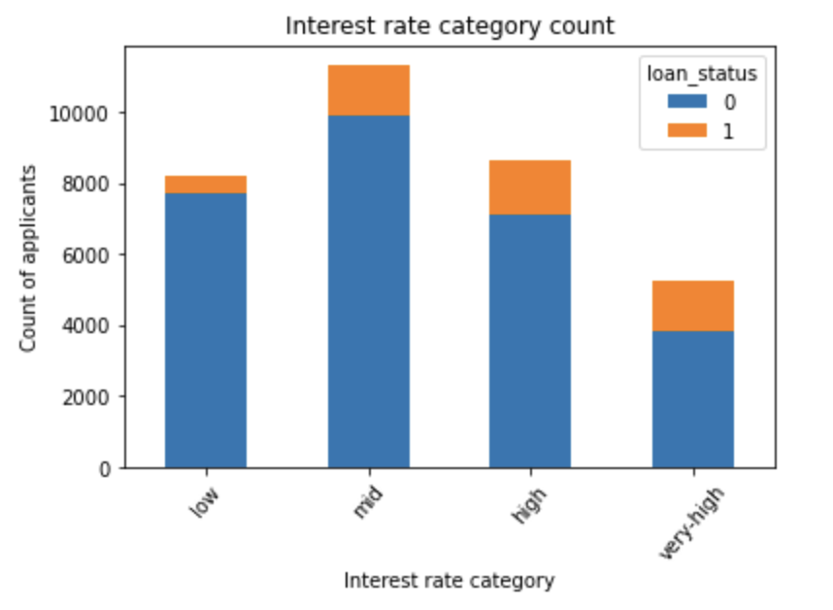
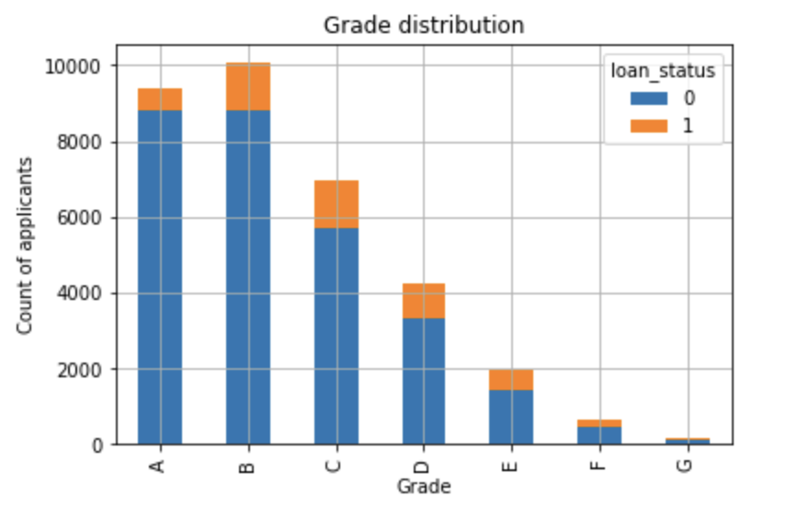
Inference of Lending Club Data Analysis
From the above chart, 27% of applicants who have borrowed loan at very high interest rate (>15% int rate) haven’t been charged off the loan.
From the above chart, Loans given for applicants under D and E grade are high risky loans as 24% of applicants under these grades have failed to pay the loan.

Slide 7
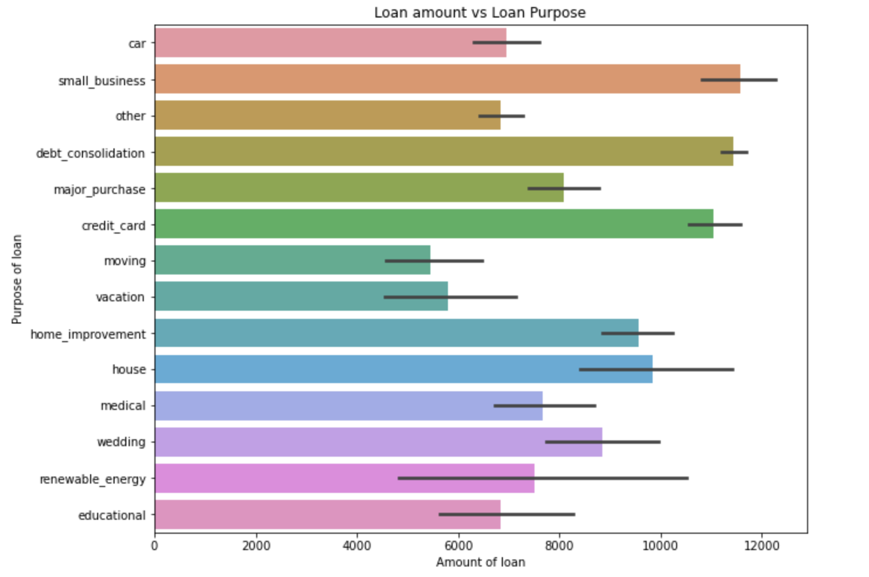
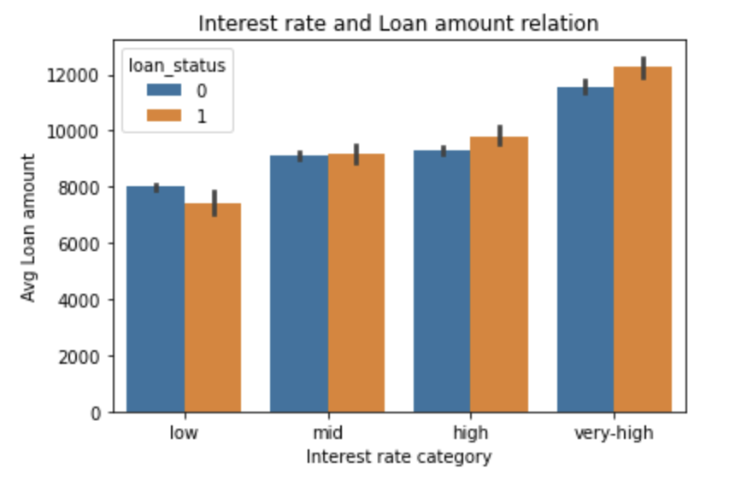
Inference of Lending Club Data Analysis Cont..
From the above chart, applicants with loan purpose as “credit card payment”, “debt consolidation” and “small business” can be considered as high-risk loans.
From the above chart, increase in the interest rate and loan amount increases the probability of loan being defaulted

Slide 8
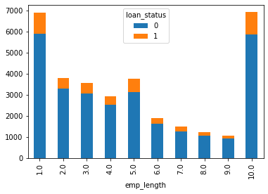
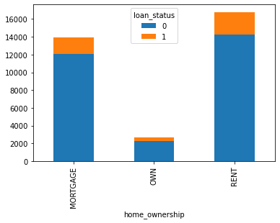
Inference of Lending Club Data Analysis Cont..
From the above chart, it is difficult to predict the loan applicants' behaviors since we see more defaulters in the group with one-year experiences and 10 years experienced applicants
From the above chart, people who are in rented home and own mortgages are more susceptible to become defaulters

Slide 9
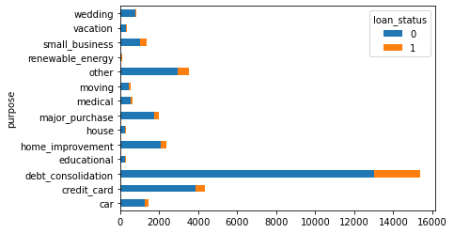
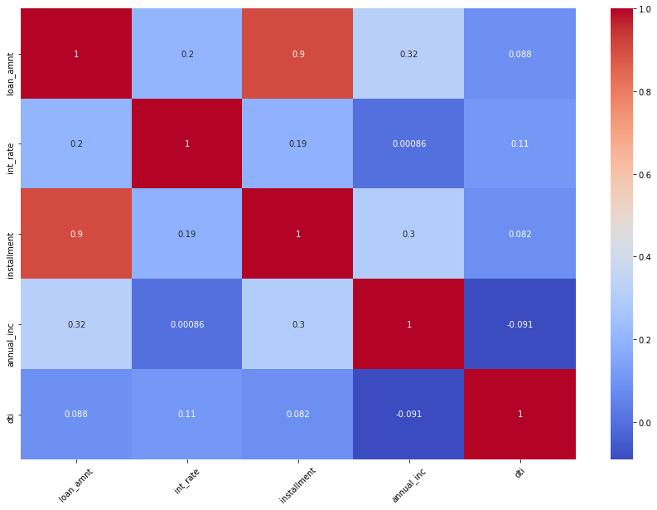
Inference of Lending Club Data Analysis Cont..
From the above chart, it is clear that people who are in the process of dept consolidation are more prone to be defaulters
From the above chart, we can infer that people who borrowed money with high interest rate, more installments and more dti are prone to be defaulters

Slide 10
Final Recommendations to Business(Investors)
Loan for small business has the highest probability of Likely to be as a Defaulter of 26%. So, bank should take extra caution while approving the loan for purpose of 'small business’.
Applicants with loan purpose as “credit card payment” or “debt consolidation” can be considered as high-risk loans.
Increase in Loan Amount is increasing the probability that person will default (increasing with highest at 25000 & above bracket)
Increase in interest rate is increasing the probability that person will default (increasing with highest at 15% & above bracket)
Applicants who are Self-Employed and less than 1 year of experience are more probable of Likely to be Defaulter
Low-income range – People in the lower income bucket are more defaulters
Applicants who are trying to consolidate the loans are more prone to become defaulters.
1
2
3
4
5
6
7

